Slide 1
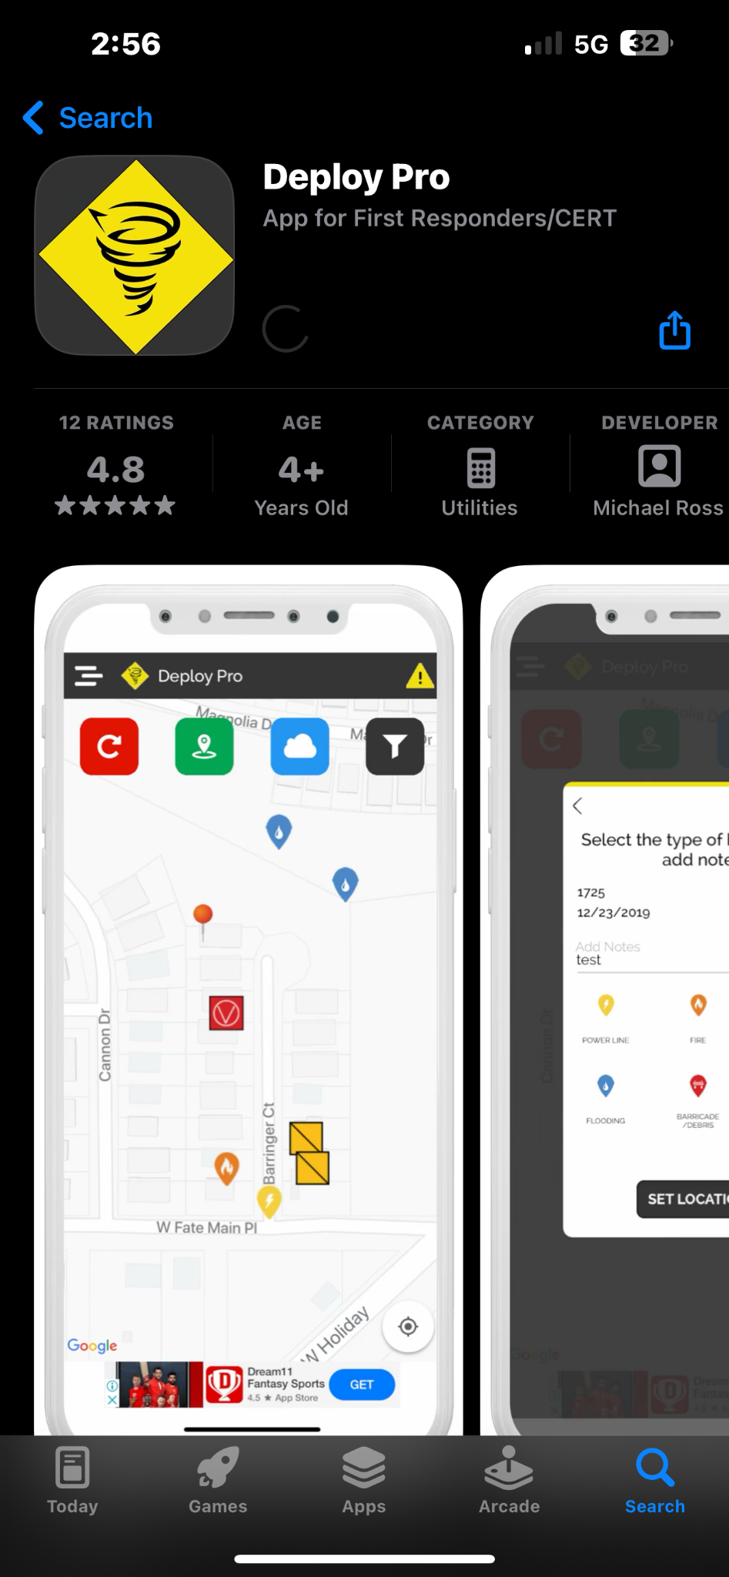
DOWNLOAD DEPLOY PRO

Slide 2
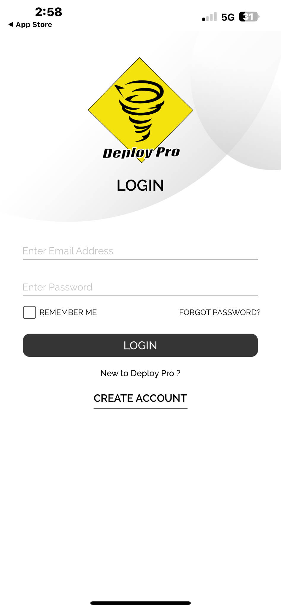
CLICK CREATE ACCOUNT

Slide 3
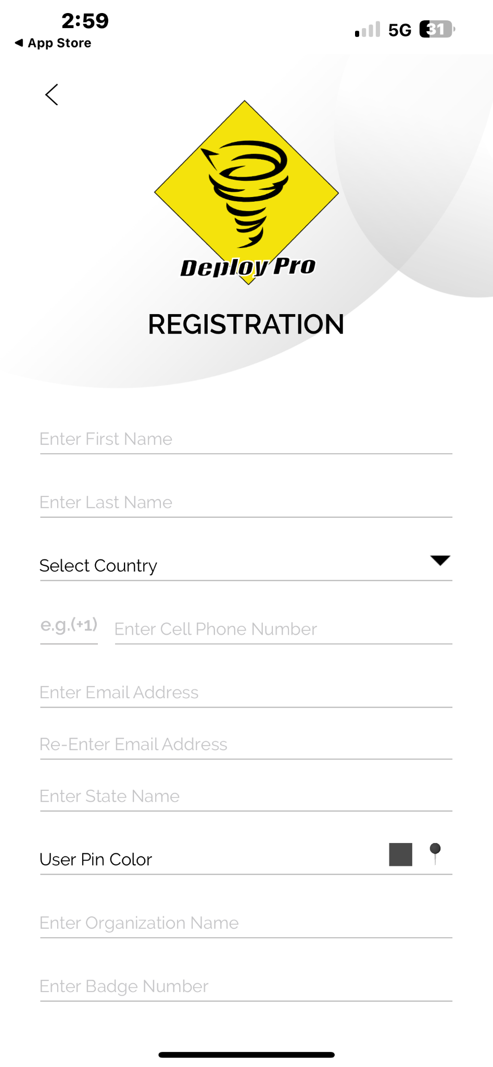
FILL OUT INFORMATION

Slide 4
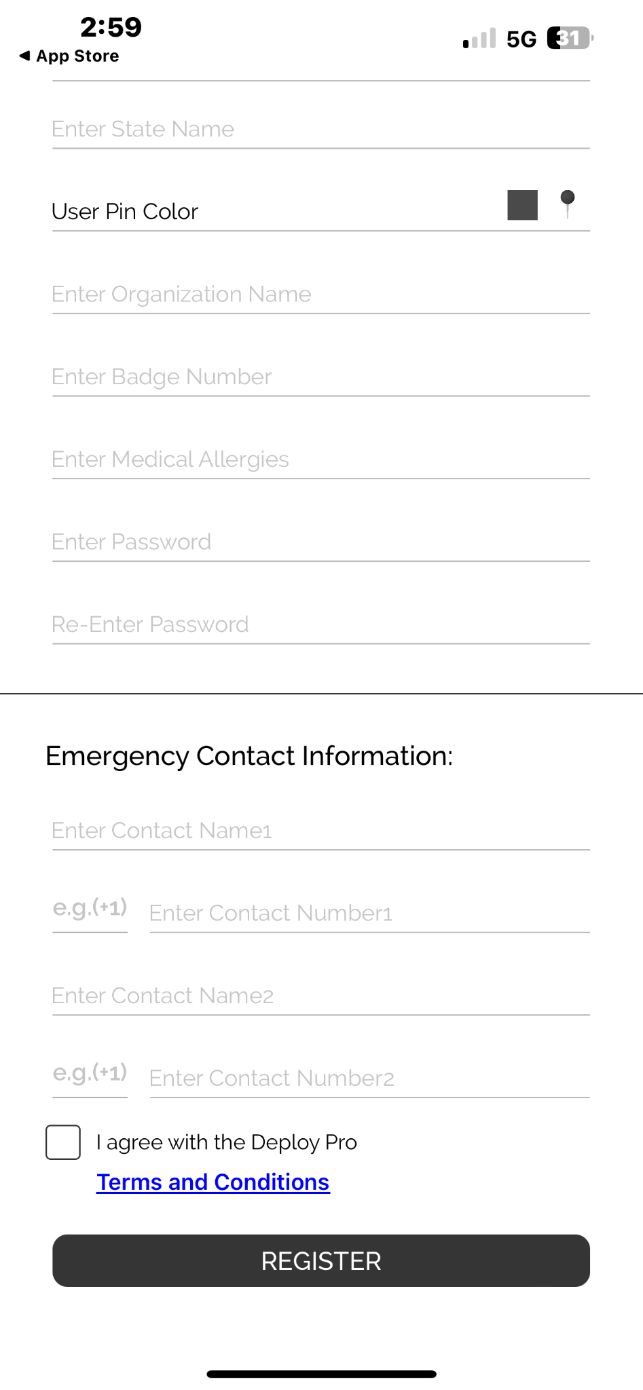
FILL OUT EMERGENCY INFO
CLICK I AGREE WITH TERMS

Slide 5
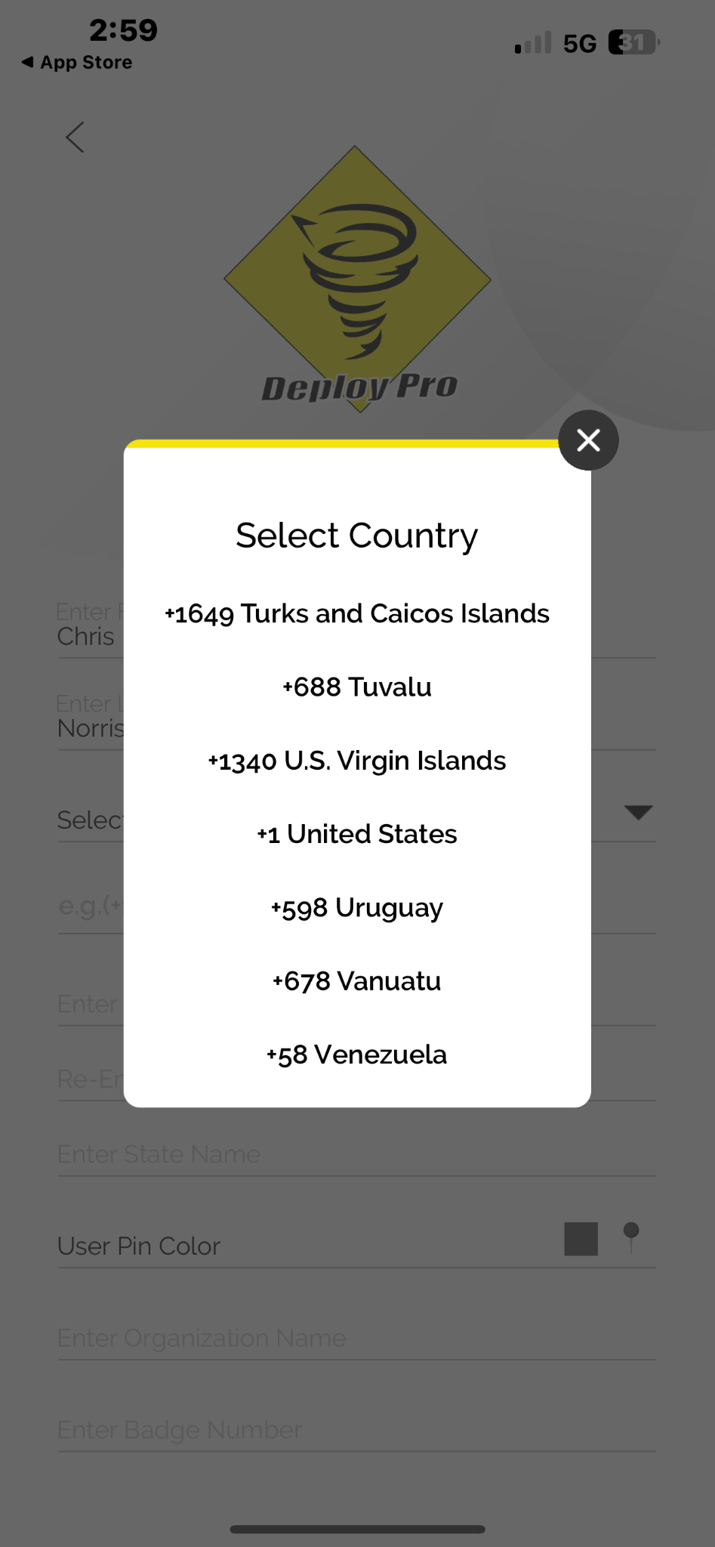
FOR LOCATION SCROLL ALL THE WAY DOWN
AND CLICK UNITED STATES

Slide 6
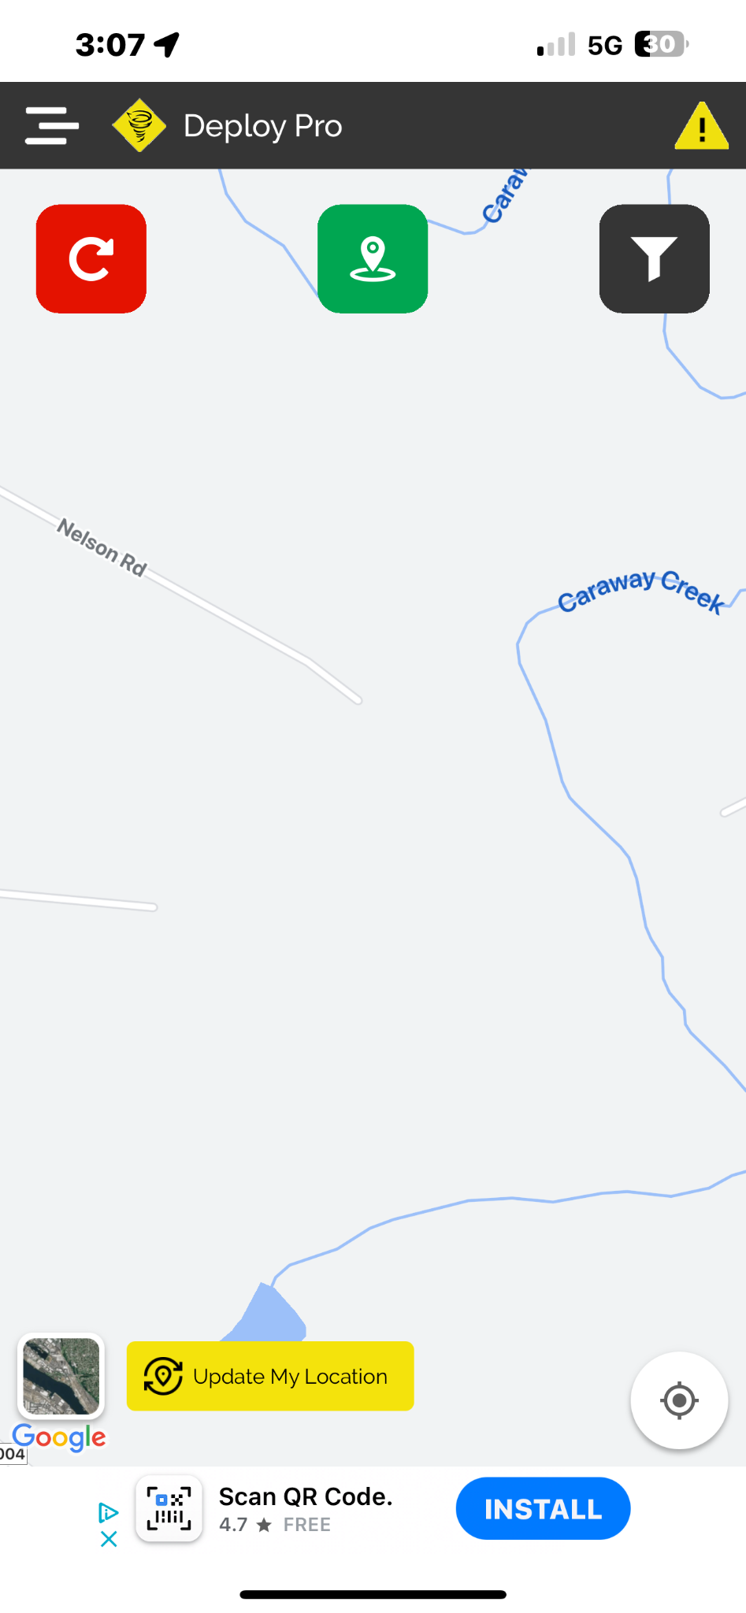
HOME SCREEN

Slide 7
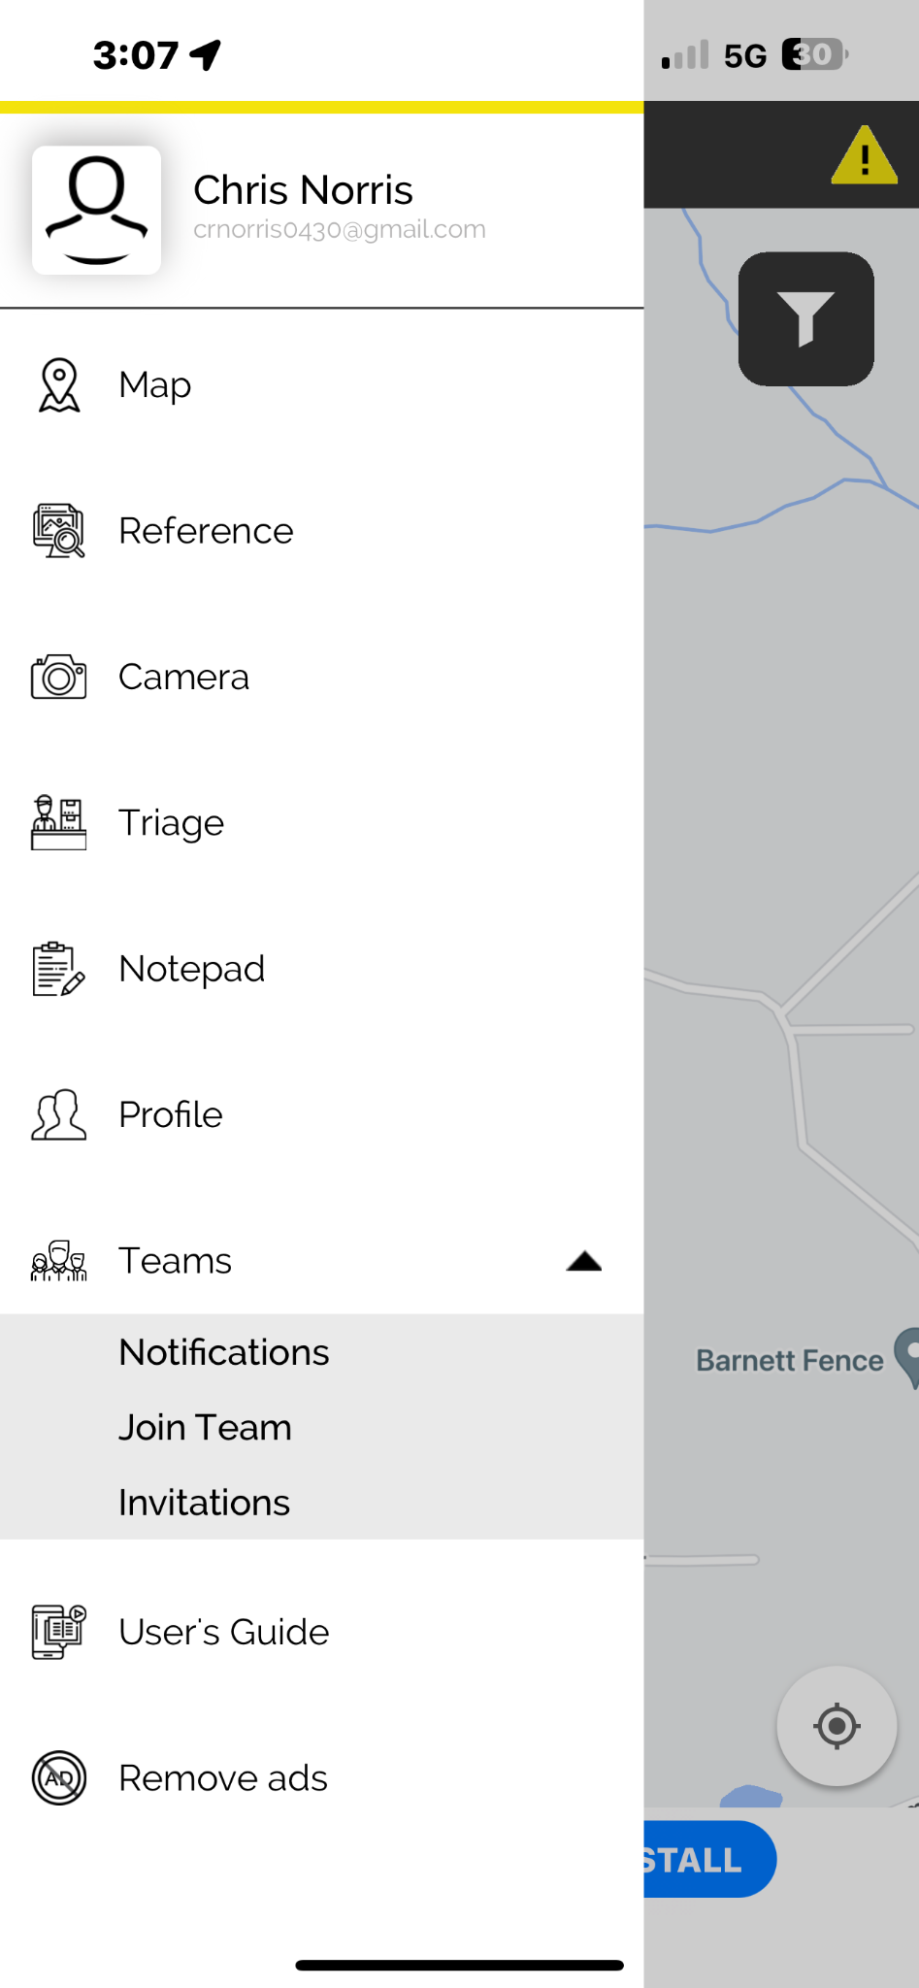
CLICK THE MENU BUTTON ON THE SIDE AND
CLICK TEAMS
THEN CLICK JOIN TEAM

Slide 8
CLICK JOIN AT THE BOTTOM OF THE PAGE

Slide 9
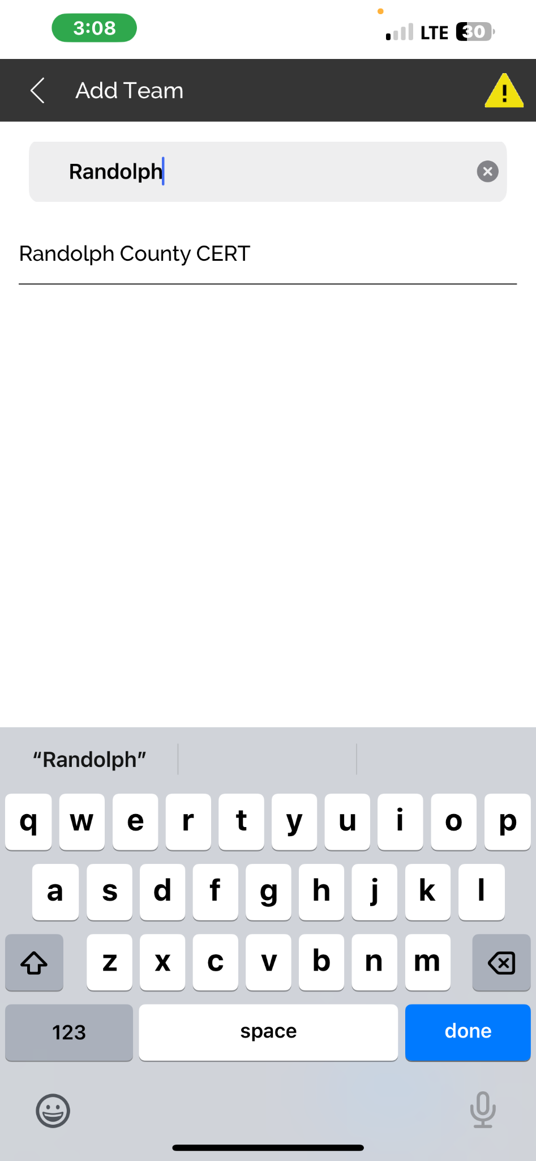
SEARCH RANDOLPH COUNTY CERT IN THE
SEARCH BAR AND CLICK ON RANDOLPH
COUNTY CERT

Slide 10
AFTER YOU CLICK ON JOIN TEAM A REQUEST WILL BE SENT TO JOIN THE TEAM AND WILL BE APPROVED
AFTER APPROVAL YOU WILL BE ASKED TO LOGIN AGAIN

Slide 11
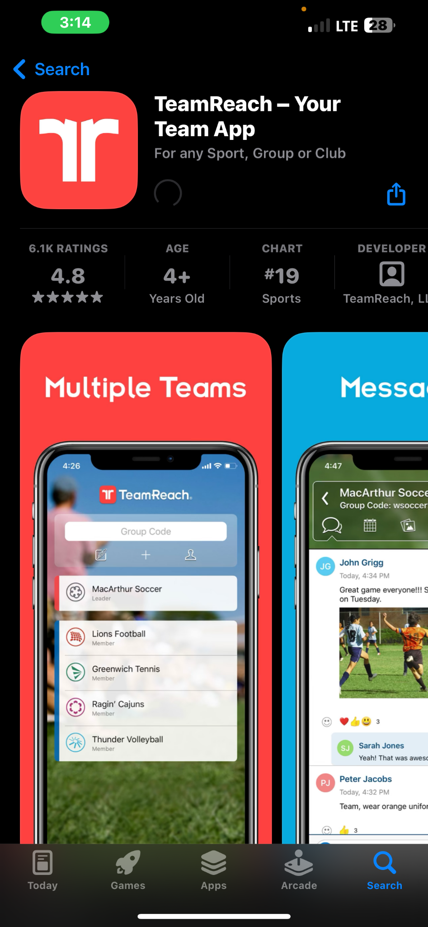
DOWNLOAD TEAM REACH

Slide 12
OPENING PAGE
CODE FOR TEAM IS “CERT0383”

Slide 13
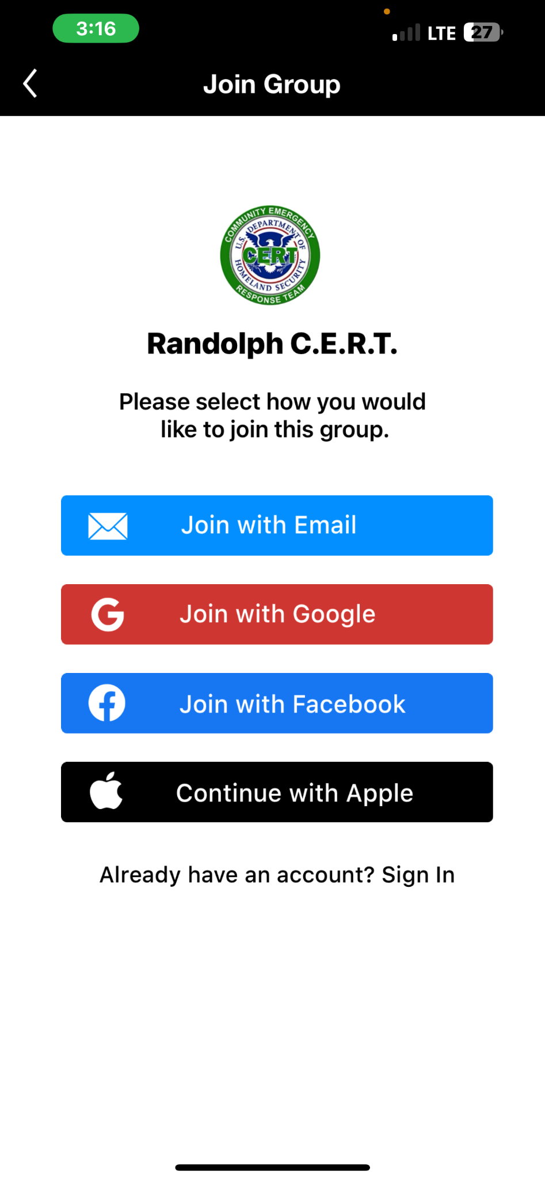
CHOOSE HOW YOU WANT TO SIGN UP

Slide 14
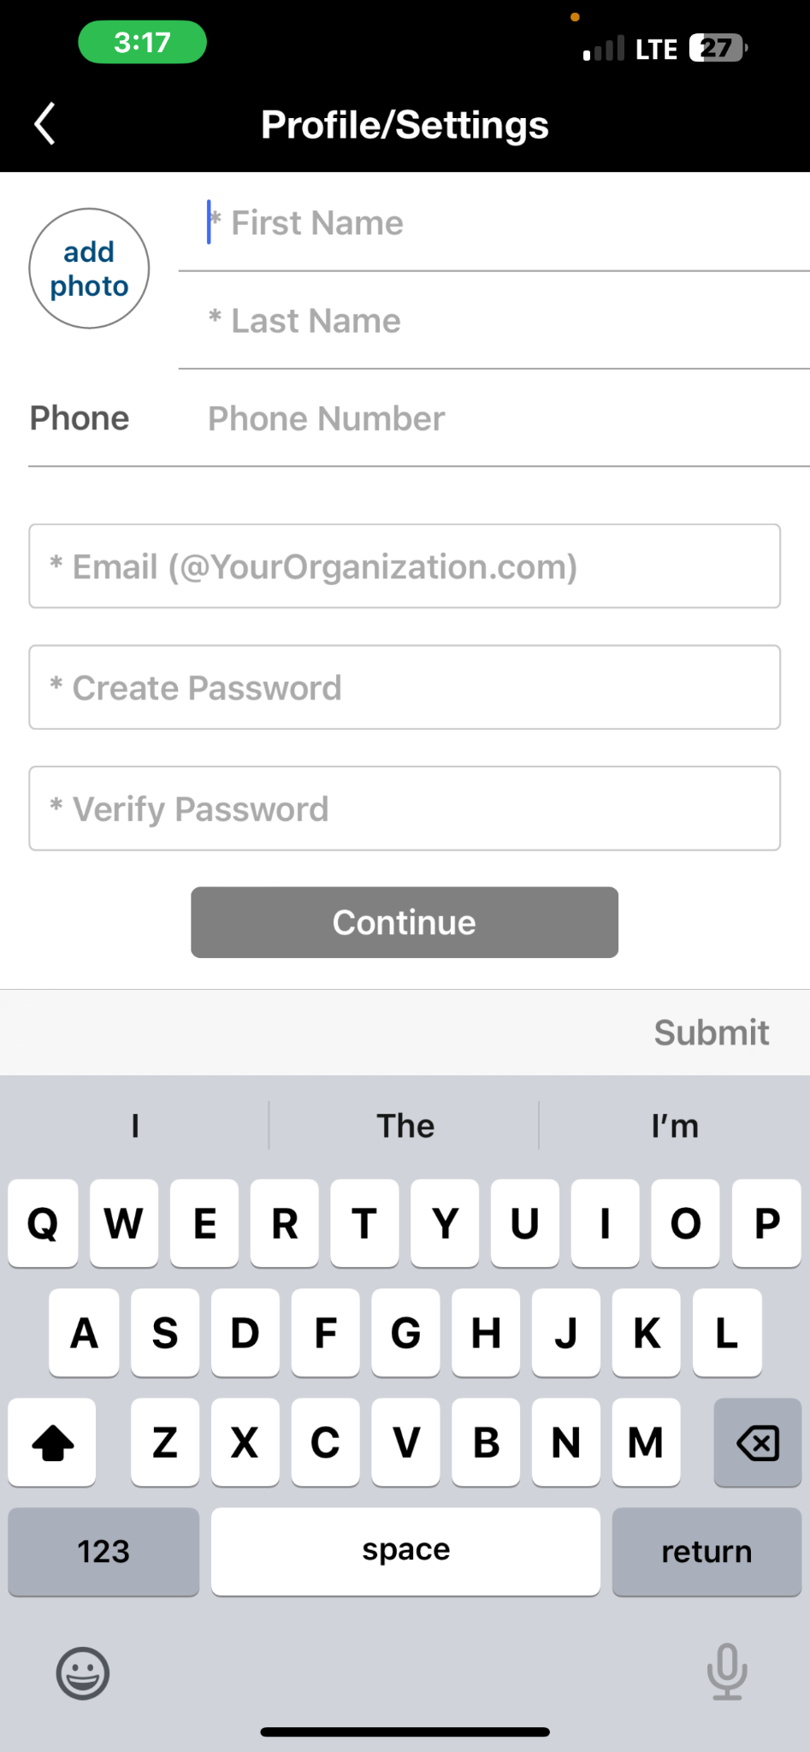
THIS IS THE SIGNUP SCREEN FOR EMAIL
OPTION

Slide 15
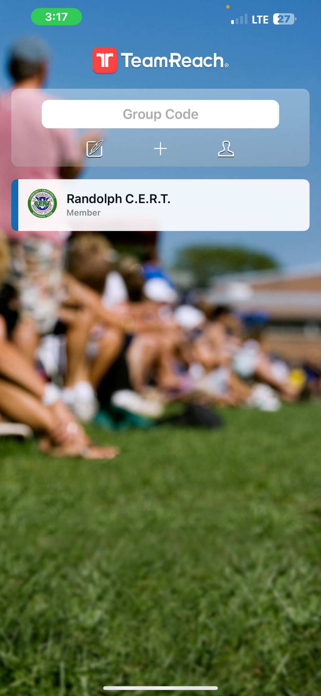
AFTER YOU SIGN UP THIS IS THE PAGE IT WILL
TAKE YOU TO

